Slide 1
Includem Multiple Risk Programme: part of Glasgow City Youth Health Service
For young people in Glasgow aged 12-19
Holistic, early intervention and prevention
Confidential
Personalised
Evening appointments
Follow us on twitter: @includem2000
includem.org

Slide 2
Support Available
Clinical
Non Clinical
Mental Health
Sexual Health
Weight
Risky Behaviours
Housing
Employability
Money Worries
Relationships
Advocacy
Follow us on twitter: @includem2000
includem.org

Slide 3
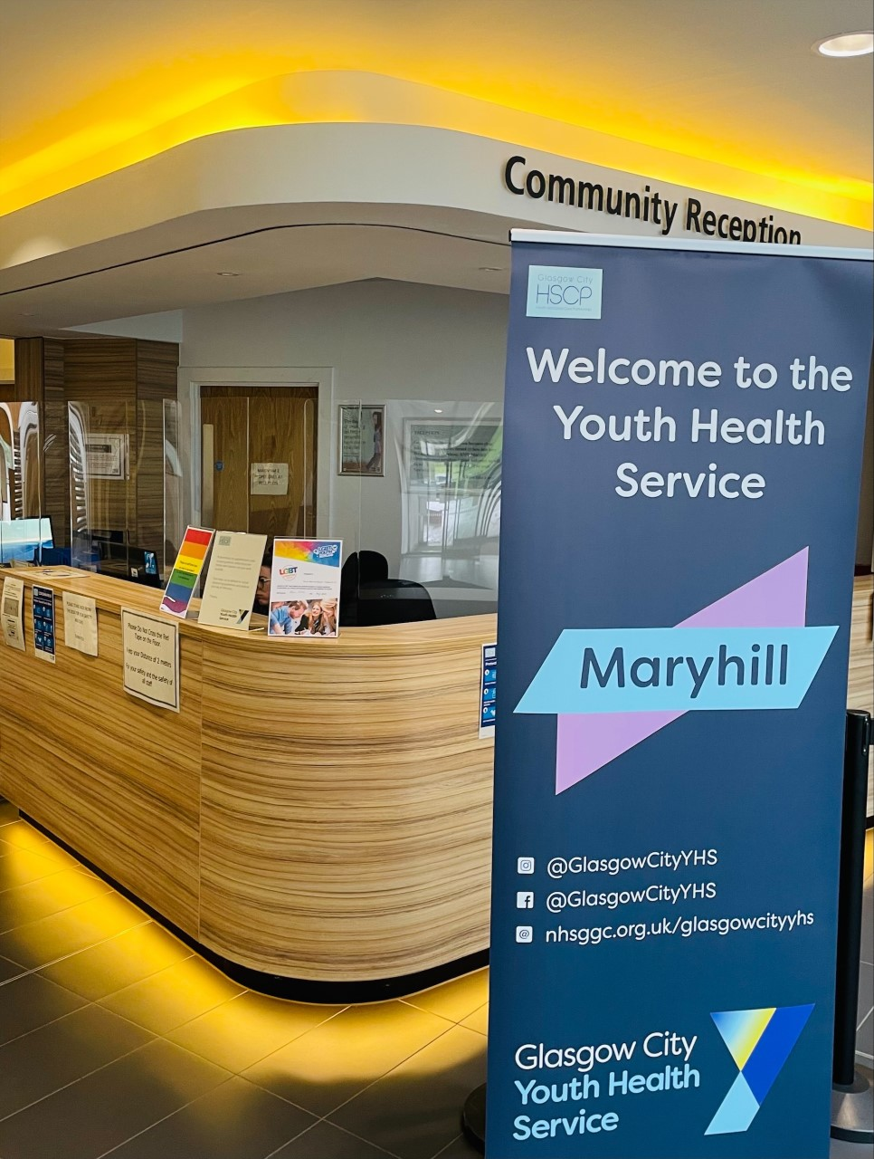
Where?
9 venues throughout Glasgow City
Appointments with Nurse or Counsellor – in-person, virtual and telephone
Venue and Outreach appointments with Multiple Risk Workers
Follow us on twitter: @includem2000
includem.org

Slide 4
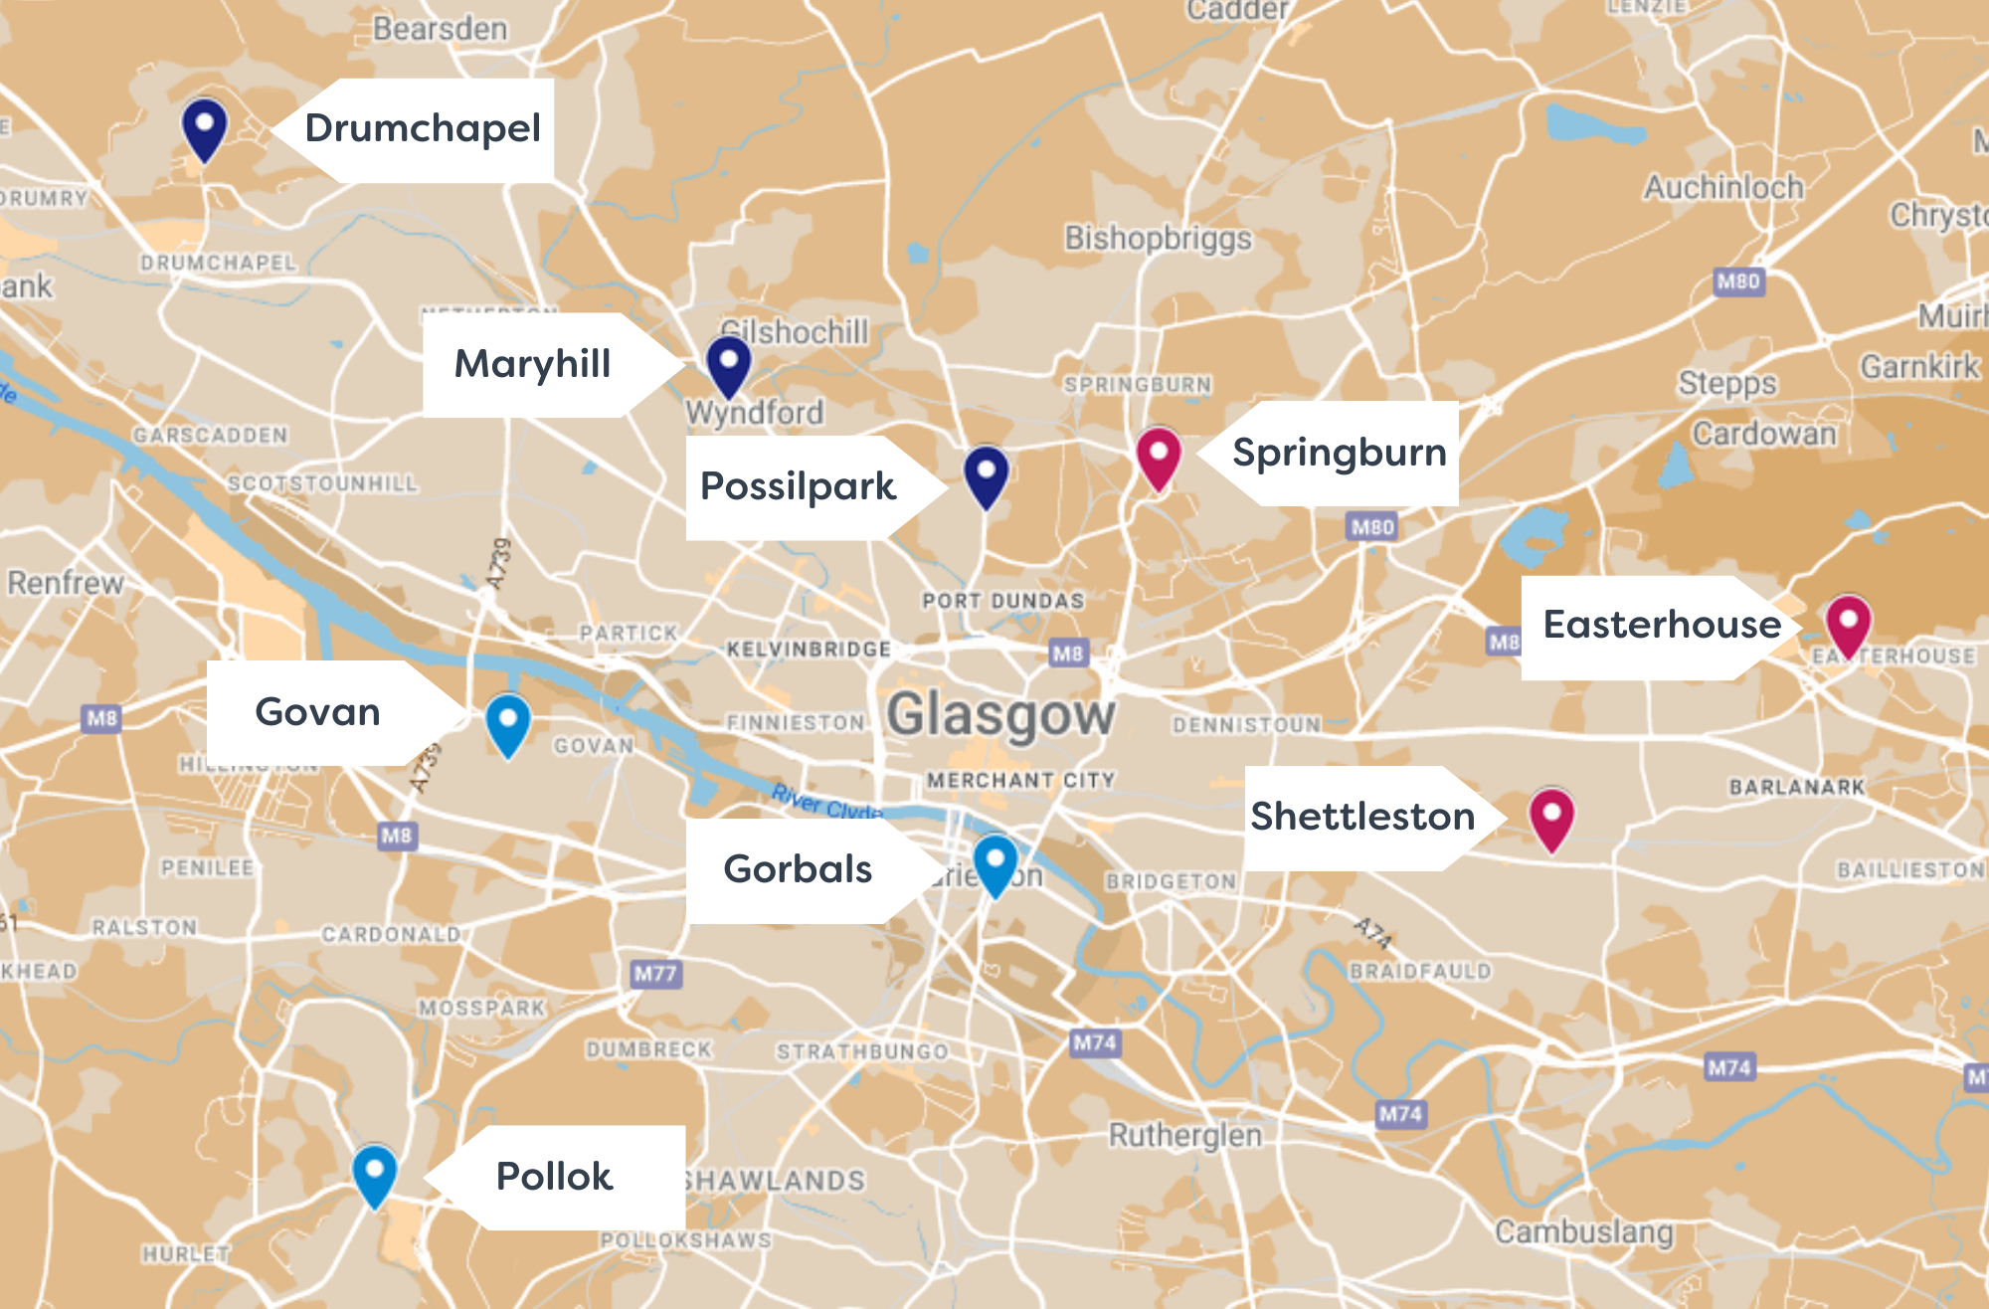
Follow us on twitter: @includem2000
includem.org

Slide 5
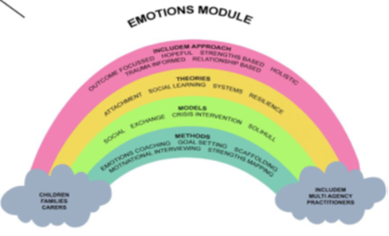
Multiple Risk Programme
Assessment
Setting goals and developing a Personal Plan
Structured modules – A Better Life Toolkit
Structured coaching conversations
Review and disengagement
Follow us on twitter: @includem2000
includem.org

Slide 6
A Better Life
Justice and Risky Behaviours
Emotions
Understanding How Others Feel
Problem Alcohol & Substance Use
Beating Boredom
Education, Training & Employment
This Is My Life
A Better Life
This Is My Life
Offending and Risk Taking Behaviours
Managing My Emotions
Understanding How Others Feel
Drugs and Alcohol
People In My Life
Health and Wellbeing
Beating Boredom
Independent Living
Education, Training and Employment
This Is My Future
Bereavement and Loss
Harmful Sexual Behaviour
People In My Life
Health & Wellbeing
Independent Living
This Is My Future
Follow us on twitter: @includem2000
includem.org

Slide 7
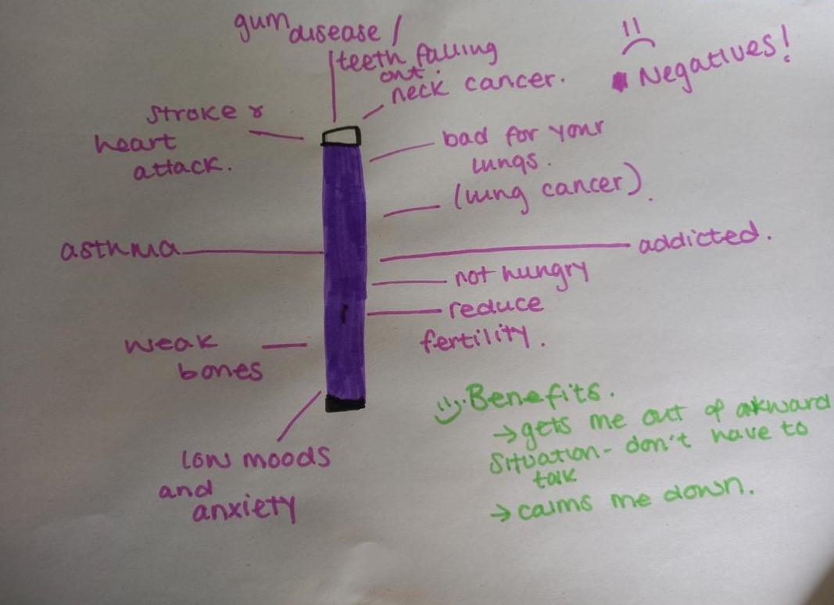
Risky Behaviours
Follow us on twitter: @includem2000
includem.org

Slide 8
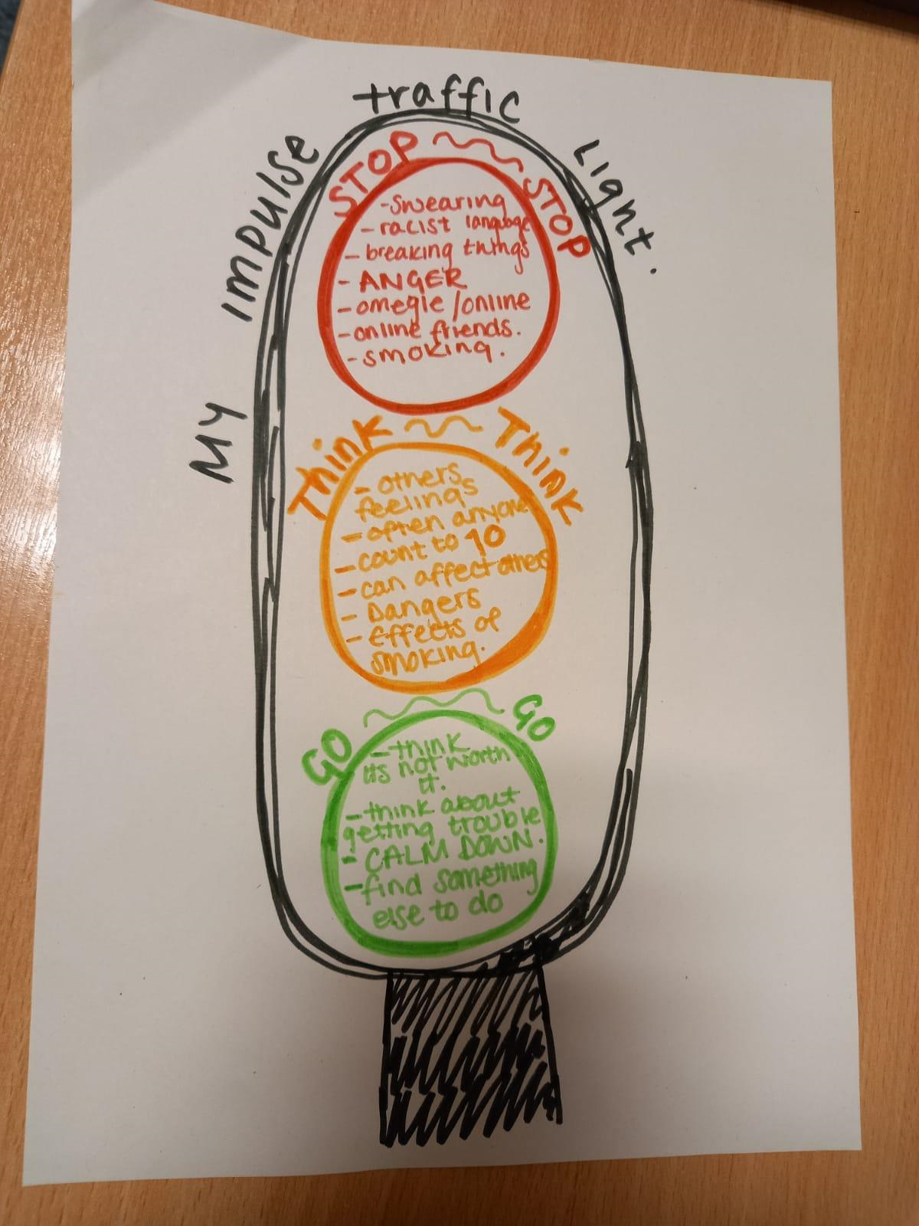
Emotions
Follow us on twitter: @includem2000
includem.org

Slide 9
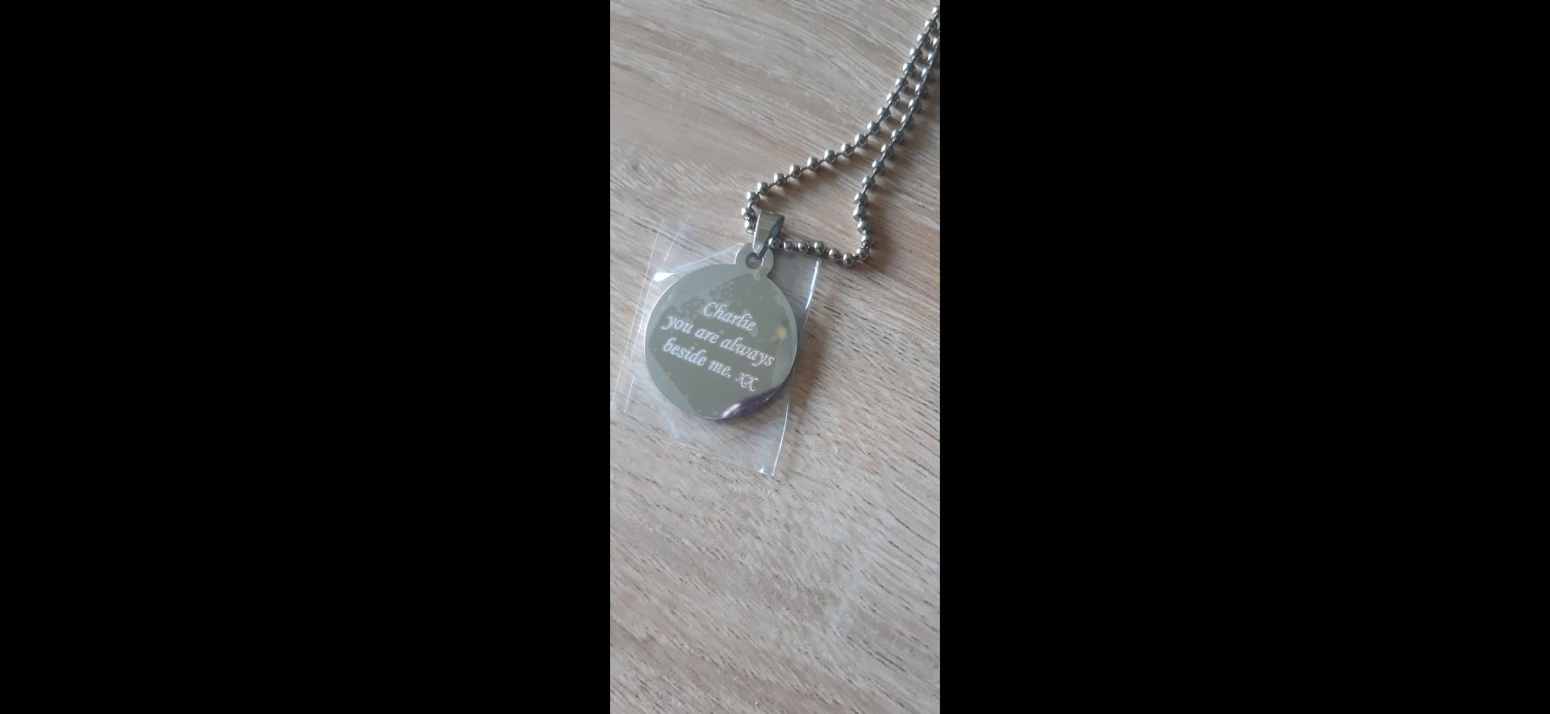
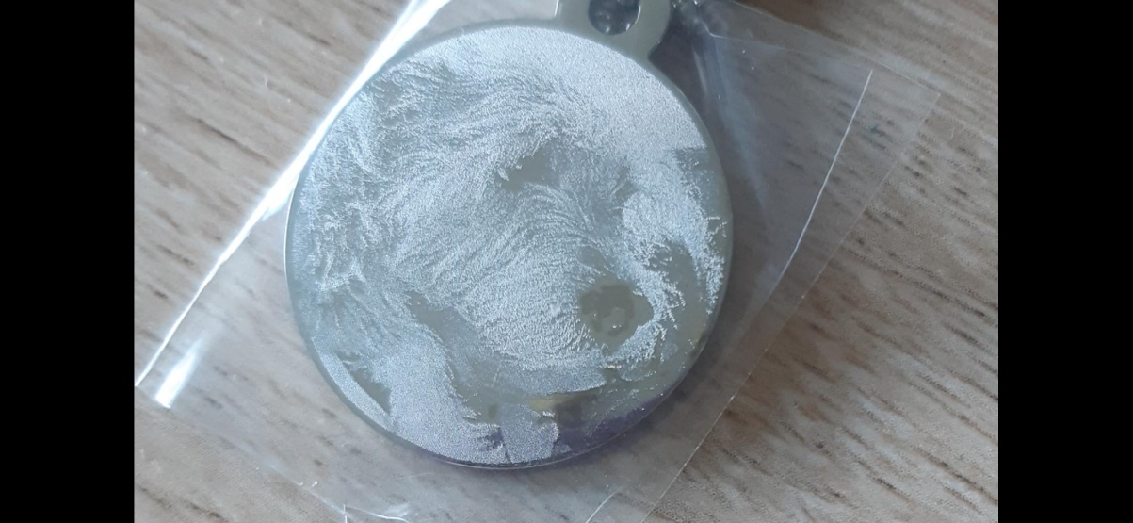
Emotions …
Follow us on twitter: @includem2000
includem.org

Slide 10
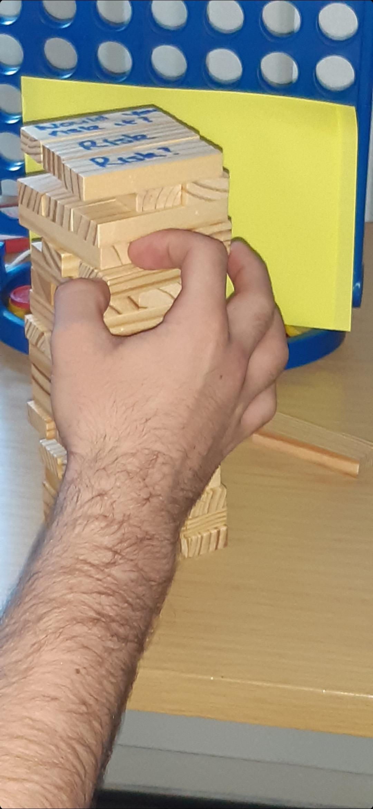
Fun – adapted to
leaning styles
Follow us on twitter: @includem2000
includem.org

Slide 11
Some stats ….
July 2021 – June 2022
Number of referrals - 173
Number of appointments - 1314
Number of community outreach visits – 151
Most common reasons for referral –
alcohol use
drug use
risk of offending
non-engagement in education/employment
vaping
Follow us on twitter: @includem2000
includem.org

Slide 12
Making a referral
Referrals are made to Youth Health Service and are triaged to most appropriate service
Young person can refer themselves
If professional (teacher, G.P. etc.) referring, they should ensure young person gives consent
Phone the YHS team on 0141 451 2727
https://www.nhsggc.scot/hospitals-services/services-a-to-z/glasgow-city-youth-health-service/
Follow us on twitter: @includem2000
includem.org

